Slide 1
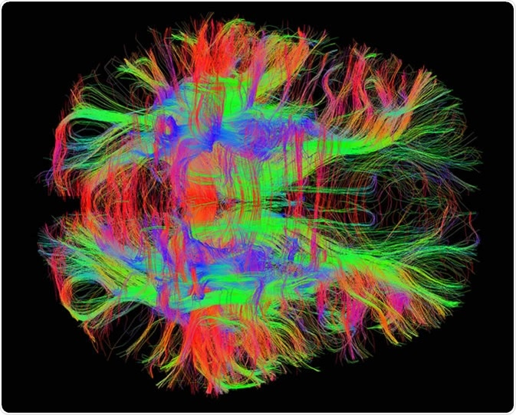
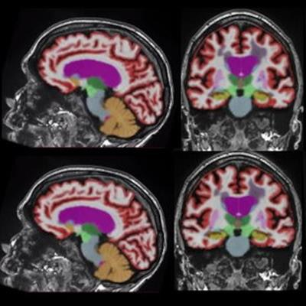
Magnetic Resonance Imaging Age and Ageing Markers
Max Korbmacher, PhD
26 September 2024
Images from mcgovern.mit.edu & AuntMinnie.com

Slide 2
Walkthrough
Parameters: Brief overview of MRI sequences & information extraction
Statistical modelling: Normative modelling & brain age
Findings: White matter ageing (if there is time, brief overview)

Slide 3
1. Parameters: MRI sequences
MANY available ones
Infinite possibilities for new sequences
Ask a physicist (e.g. Frank) for special cases
E.g., sodium imaging for potental cardiovascular disease biomarker of sodium residuls in skin and fat
Alternatively, there should be established protocols

Slide 4
1. Parameters: MRI sequences
Adjustment of scanner parameters allows to image different biophysical phenomena
Commonly used: T1, T2, T2* (diffusion) weighted, spectroscopy, functional MRI, proton density, etc.

Slide 5
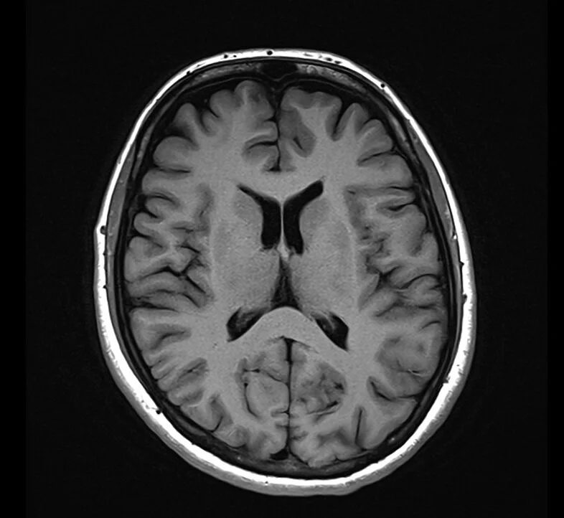
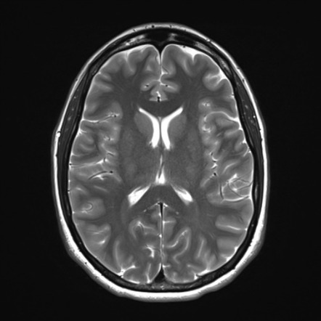
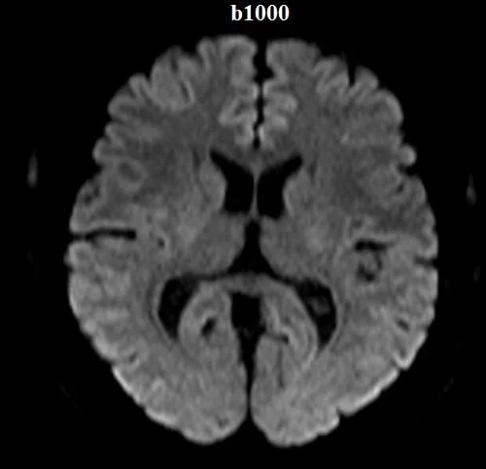
1. Parameters: MRI sequences
Adjustment of scanner parameters allows to image different biophysical phenomena
Commonly used: T1, T2, T2* (diffusion) weighted, spectroscopy, functional MRI, proton density, etc
…
McRobbie et al. (2017). MRI from Proton to Picture.
McRobbie et al. (2017). MRI from Proton to Picture.
https://mrimaster.com/characterise-image-dwi/
Notes:
Water has high signal, high density tissue such as the WM has low signal
Water has low signal as molecules diffuse easily, more structured tissue has stronger signal

Slide 6
1. Parameters: MRI sequences
Adjustment of scanner parameters allows to image different biophysical phenomena
Commonly used: T1, T2, T2* (diffusion) weighted, spectroscopy, functional MRI, proton density, etc
All have their merits, but ...
Absolutely most commonly available: T1-weighted, and very often diffusion MRI

Slide 7
1. Parameters: information extraction
Contrasts are fine, but what can we do with these?
Notes:
Some practical examples

Slide 8
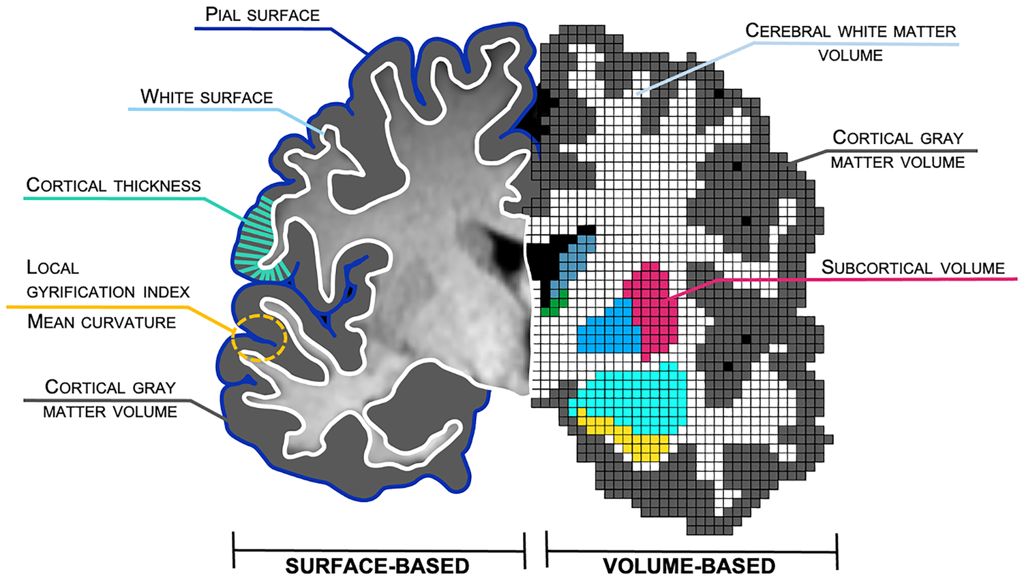
1. Parameters: information extraction
Examples for quantitative assessments:
Cortical reconstruction, metrics extraction (particularly grey matter)
Backhausen et al. (2021), Neuropsy Rev, 32 (2)
Notes:
Some practical examples

Slide 9
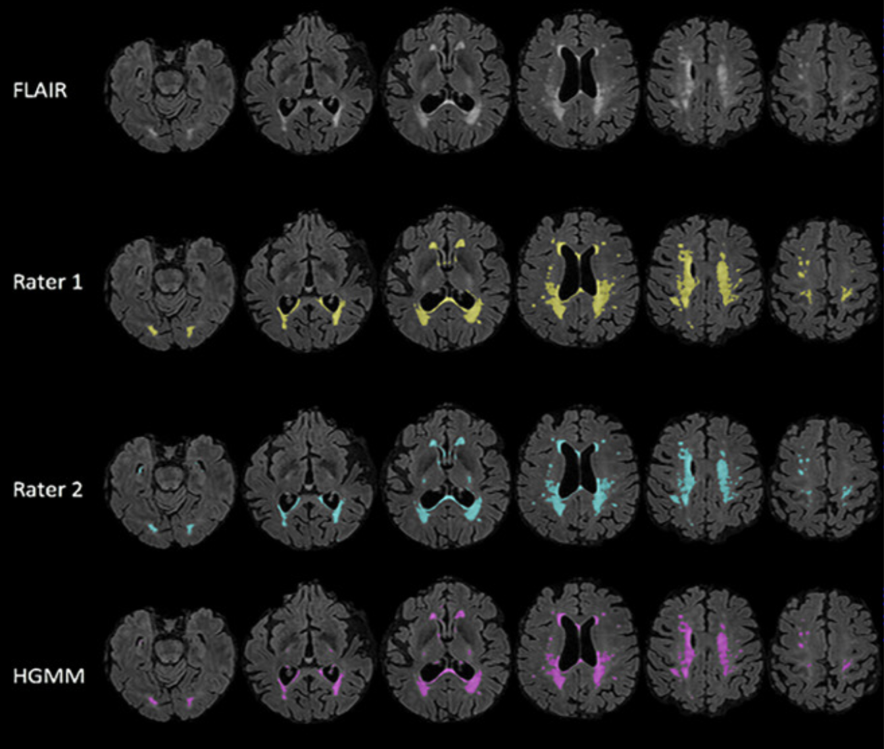
1. Parameters: information extraction
Examples for quantitative assessments:
Cortical reconstruction, metrics extraction (particularly grey matter)
Hyperintensity detection (marker for lesions)
Notes:
Some practical examples

Slide 10
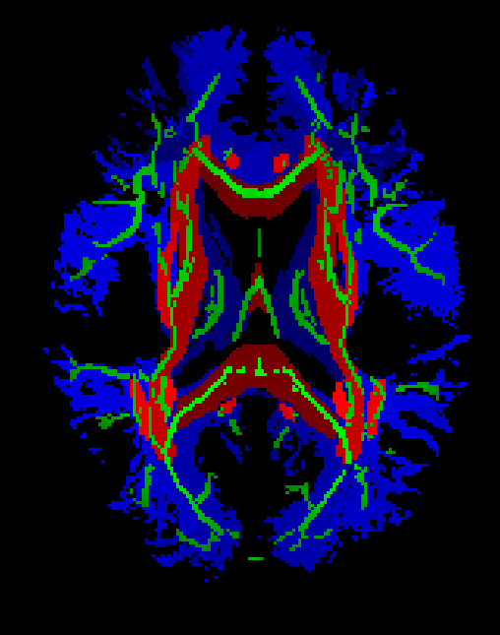
1. Parameters: information extraction
Examples for quantitative assessments:
Cortical reconstruction, metrics extraction (particularly grey matter)
Biophysical modelling (particularly white matter)
Hyperintensity detection (marker for lesions)
Korbmacher et al. (2023) HBM, 44 (10)
Notes:
Some practical examples

Slide 11
1. Parameters: information extraction
Examples for quantitative assessments:
Cortical reconstruction, metrics extraction (particularly grey matter)
Biophysical modelling (particularly white matter)
Hyperintensity detection (marker for lesions)
Useful: Many established pipelines to automate the extraction of such parameters.
Notes:
Some practical examples

Slide 12
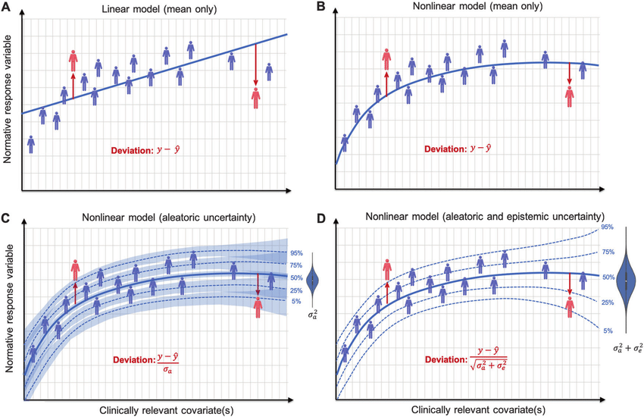
2. Normative modelling & brain age
We are interested in ageing trajectories
Hence, classical group-level comparison might not be sufficient (precision is lacking)
One approach: normative modelling
Marquand et al. (2019) Mol.Psych, 24

Slide 13
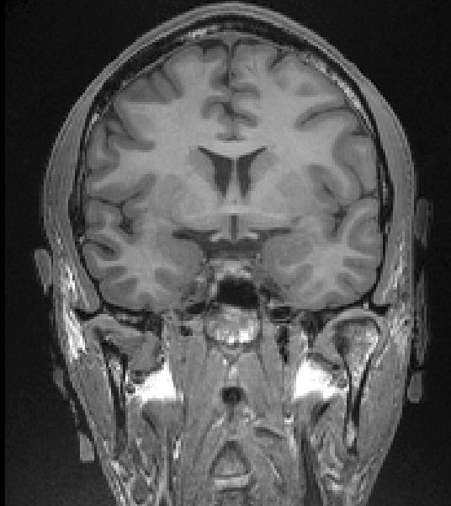
2. Normative modelling & brain age
You see that there are many MRI parameters. Many have the potential to be used as biomarkers.
Cooking them down into a simple number: brain age
Predicted brain age: 59 years old. Significant gap. Treatment applied.
Patient MRI data at first time point. 55 years of age.
Trained model assesses MRI scans automatically
Predicted brain age: 75 years old.
Gap has increased!
Conclusion
Treatment is not successful!
Patient MRI data at 2nd time point. 62 years of age.

Slide 14
2. Normative modelling & brain age
Brain age can potentially be used to assess ageing trajectories or treatment success
Ageing trajectories
Treatment success
Abnormal ageing
Normal ageing
Unsuccessful treatment
Successful treatment
Brain age
Brain age
Onset of treatment effects
Age

Slide 15
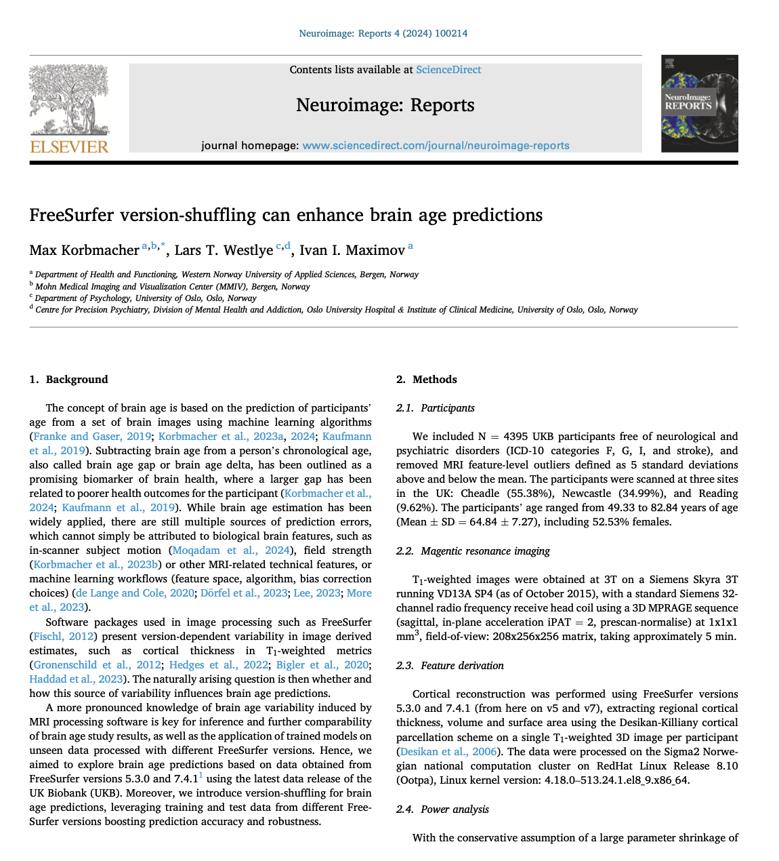
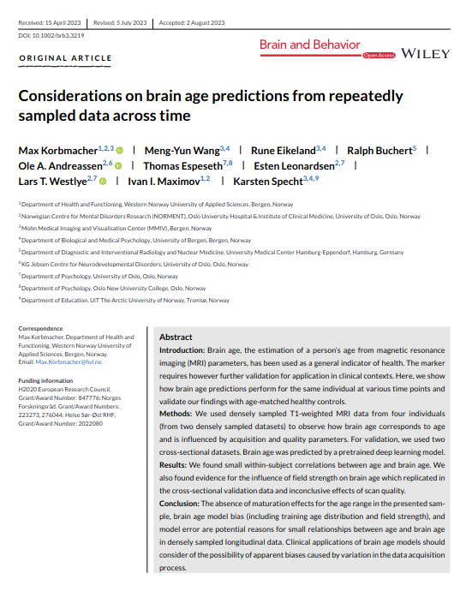
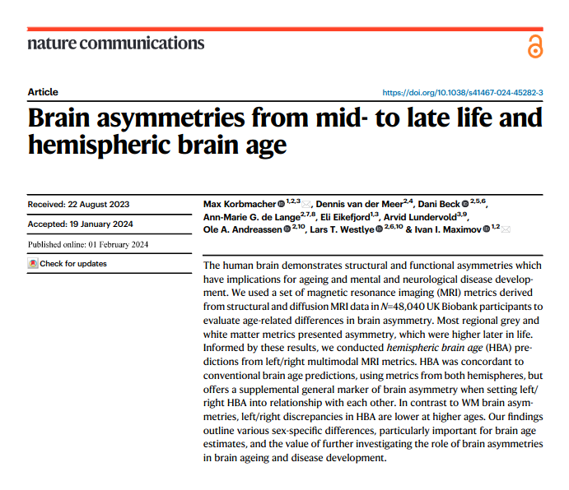
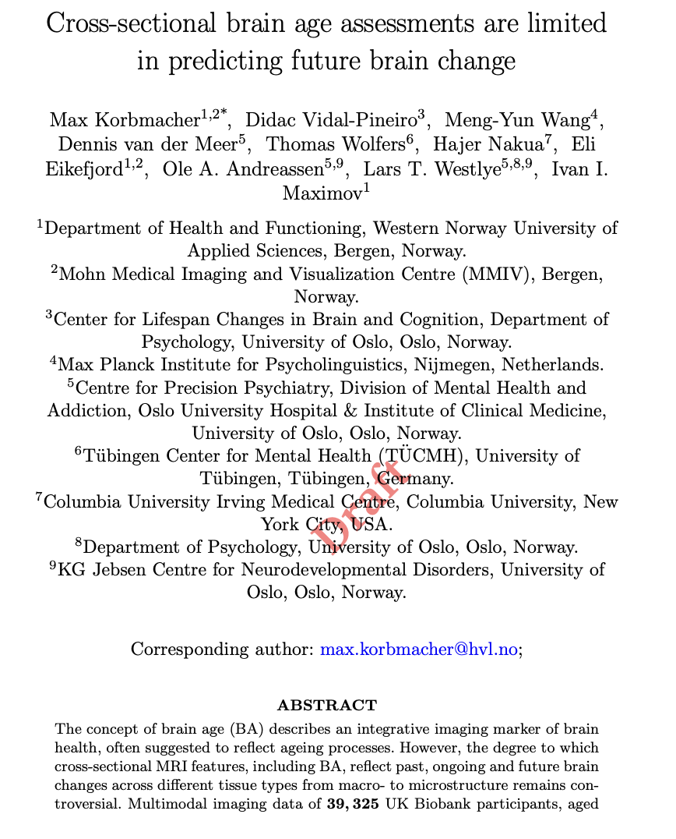
2. Normative modelling & brain age
Some of my brain age methods papers

Slide 16
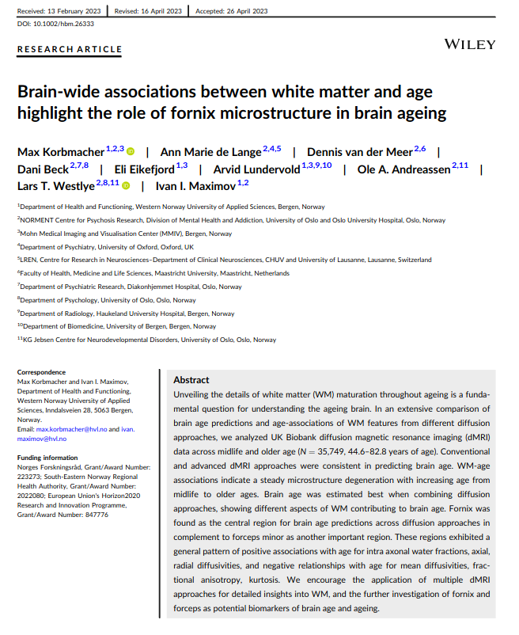
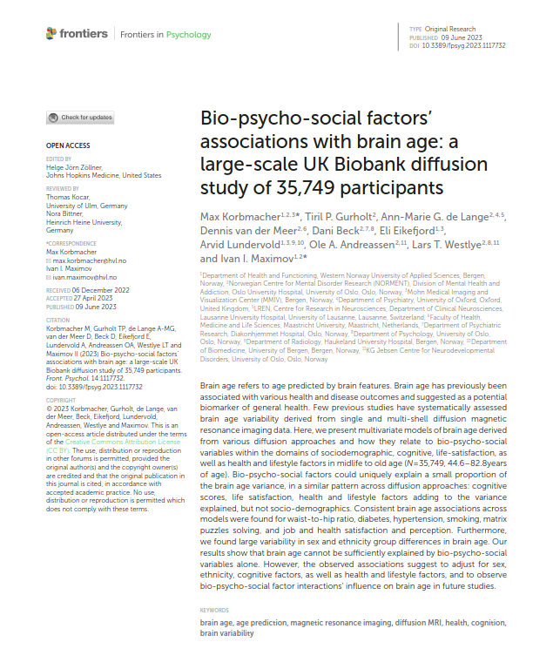
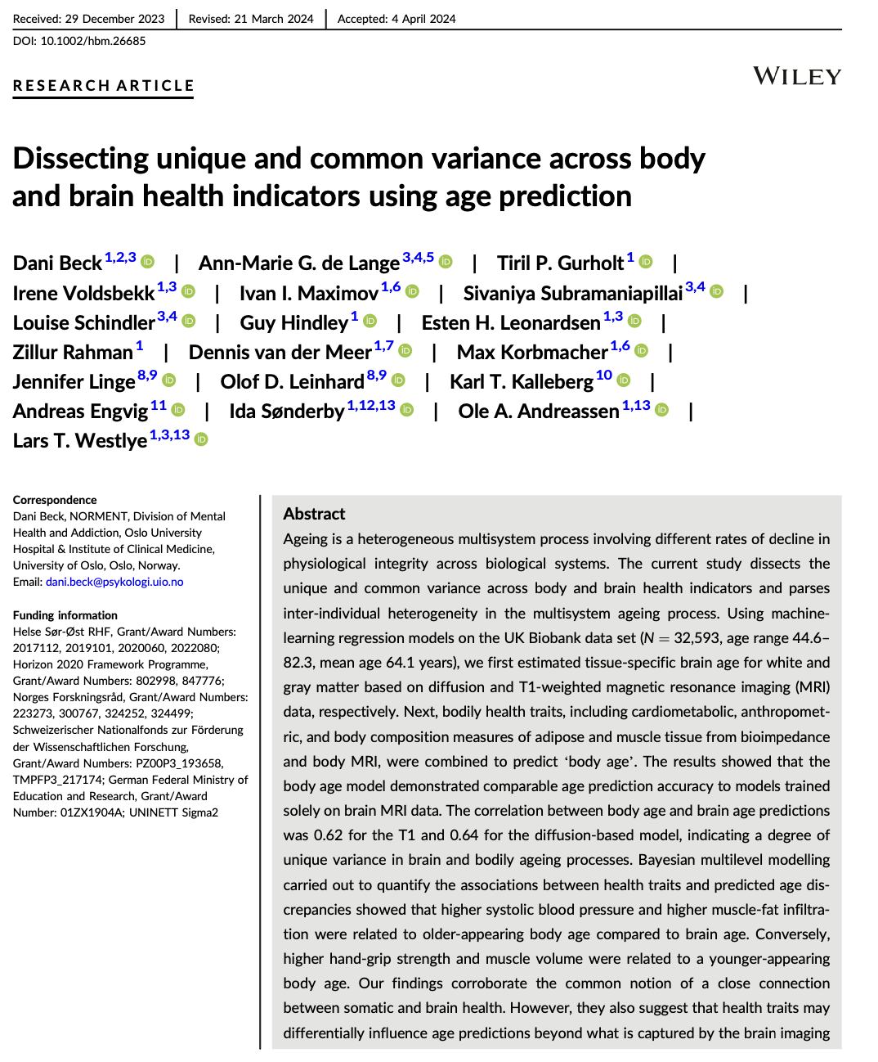
2. Normative modelling & brain age
Some of my brain age application papers

Slide 17
2. Normative modelling & brain age
Brain age can potentially be used to assess ageing trajectories or treatment success(?)
Ageing trajectories
Treatment success
Abnormal ageing
Normal ageing
Unsuccessful treatment
Successful treatment
?
?
Brain age
Brain age
Onset of treatment effects
Age

Slide 18
2. Normative modelling & brain age
Needs to be tested on clinical, and best longitudinal, data
Ageing trajectories
Treatment success
Abnormal ageing
Normal ageing
Unsuccessful treatment
Successful treatment
?
?
Brain age
Brain age
Onset of treatment effects
Age

Slide 19
3. Findings (very briefly)
Localisation
Key region of white matter age-associations: fornix (hippocamus output tract), corpus callosum
These regions’ asymmetries show also strongest age-associations
Reflected by white matter ageing as well (longitudinal evidence)

Slide 20
3. Findings (very briefly)
Imaging genetics
Gene-brain associations are small
But ... Polygenic disease risk is better reflective of longitudinal changes than cross-sectional assessments.

Slide 21
3. Findings (very briefly)
Brain age is NOT straight forward
Variability due to modelling error
Effects of field strength and image quality, modality/data
Not clear to which extent it predicts future brain change
But it is correlated to / shows group differences in bio-psycho-social factors, dieases; strongest in brain atrophy

